Slide 1

Texas oil wells produced water dataset analysis before the Permian oil shale revolution (1920 – 2010)
Springboard Capstone project I
Shubham Tiwari

Slide 2

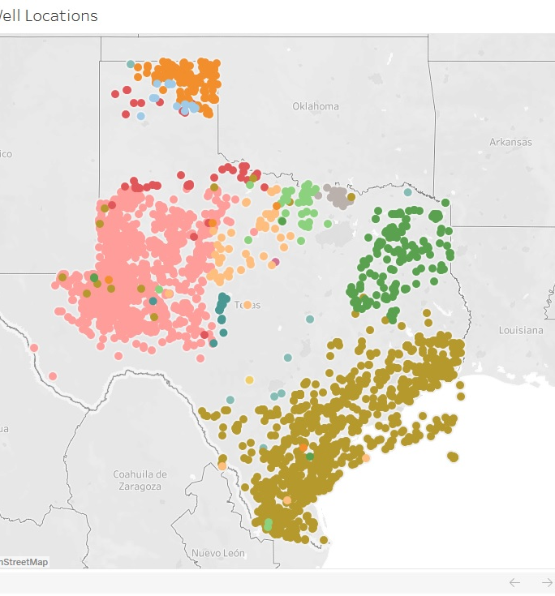
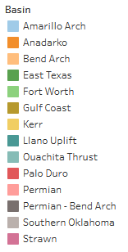
Problem Statement
whether water characteristics were significantly different before the Permian oil shale revolution in 2012, indicating that water contamination has increased due to the introduction of hydraulic fracturing;
whether depths of wells can be regressed using water quality parameters and origin basins.

Slide 3
Brief Intro to Hydraulic Fracturing

